Slide 1


Foundations of Biostatistics III
DEPH 312 Principles of Scientific Evidence
Talal Alshihayb ^{BDS, DScD}
Diplomate, American Board of Dental Public Health
Assistant Professor
Department of Preventive Dental Science, College of Dentistry, King Saud bin Abdulaziz University for Health Sciences
Department of Health Policy and Health Services Research, Henry M. Goldman School of Dental Medicine, Boston University
December 28, 2023
shihaybt@ksau-hs.edu.sa

Slide 2
Recap
Study tasks
Measures of disease occurrence
Measures of association
Study designs
Validity and precision
Random and systematic errors in research
Causality and causal effects
Variables and their description
Measures of central tendency and dispersion
Types of distributions and the theoretical distribution

Slide 3

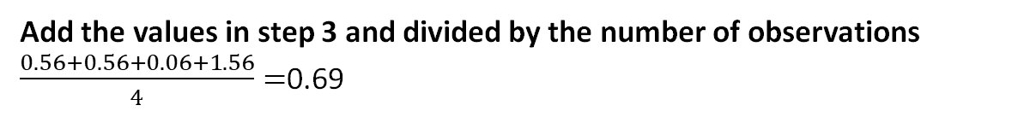
Population variance
Ages of a population of 4 people
19 19 20 21
1
Calculate m$ean=\frac{19+19+20+21}{4}=19.75$
Subtract the mean from each value
19 - 19.75, 19 - 19.75, 20 - 19.75, 21 - 19.75
-0.75, -0.75, 0.25, 1.25
2
3
Square the values in step 2
0.56, 0.56, 0.06, 1.56
4
Add the values in step 3 and divided by the number of observations
$\frac{0.56+0.56+0.06+1.56}{4}=$0.69

Slide 4





Population
Sample
Because of limited
We want to get the distribution in the population (mean and variance)
We get the distribution in the sample (mean and variance)
Hope to approximate the population

Slide 5
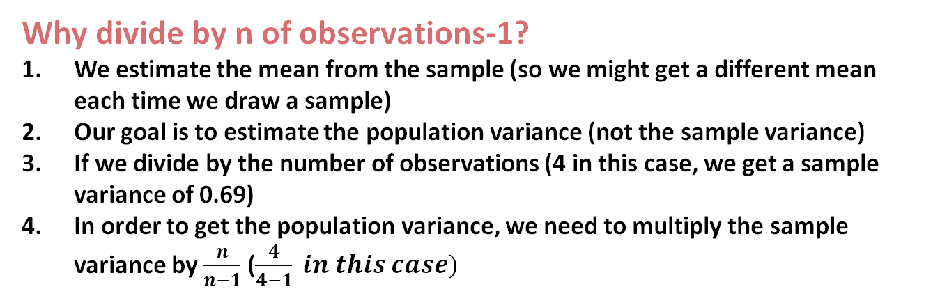
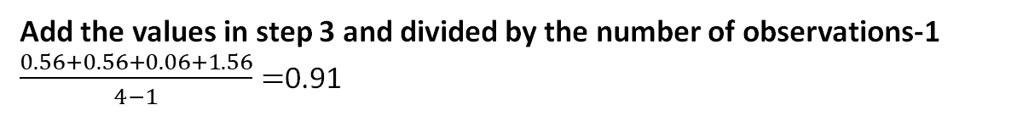
Sample variance
Why divide by n of observations-1?
We estimate the mean from the sample (so we might get a different mean each time we draw a sample)
Our goal is to estimate the population variance (not the sample variance)
If we divide by the number of observations (4 in this case, we get a sample variance of 0.69)
In order to get the population variance, we need to multiply the sample variance by $\frac{n}{n−1}$ ($\frac{4}{4−1} in this case)$
Ages of a sample of 4 people (out of a larger population)
19 19 20 21
1
Calculate m$ean=\frac{19+19+20+21}{4}=19.75$
$$\frac{0.56+0.56+0.06+1.56}{4} ∗ \frac{4}{4−1}=\frac{0.56+0.56+0.06+1.56}{4−1}$$
Subtract the mean from each value
19 - 19.75, 19 - 19.75, 20 - 19.75, 21 - 19.75
-0.75, -0.75, 0.25, 1.25
2
3
Square the values in step 2
0.56, 0.56, 0.06, 1.56
4
Add the values in step 3 and divided by the number of observations-1
$\frac{0.56+0.56+0.06+1.56}{4−1}=$0.91

Slide 6
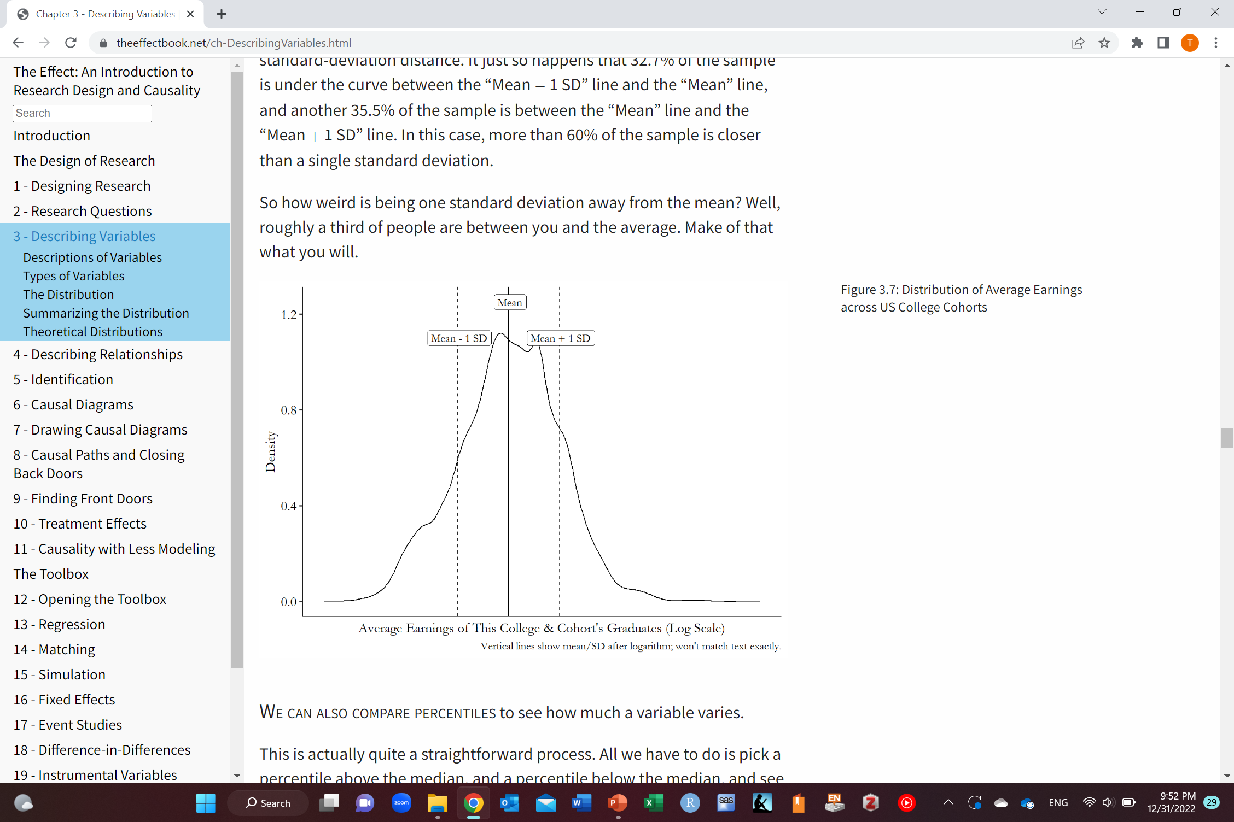
Getting sense of standard deviation
32.7% of data under the curve
35.5% of data under the curve
The effect: An Introduction to Research Design and Causality by Nick Huntington-Klein https://theeffectbook.net/

Slide 7
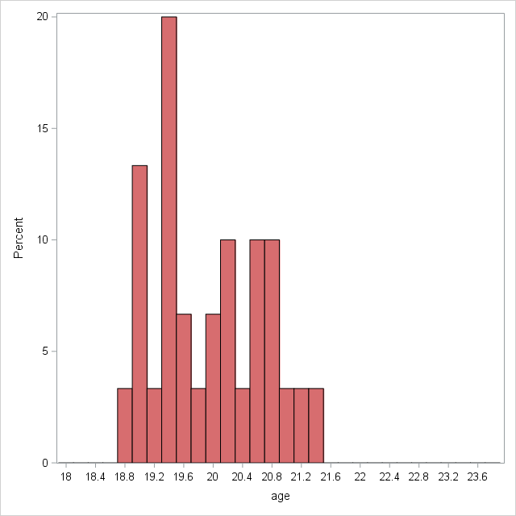
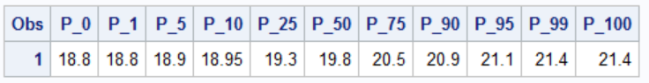
Range
0th percentile
Minimum value
100th percentile
Maximum value
Median
The person right in the middle
Half the batch is younger than him/her and half is older

Slide 8
Interquartile range (IQR)
25th percentile
75th percentile
Median
The person right in the middle
Half the batch is younger than him/her and half is older

Slide 9
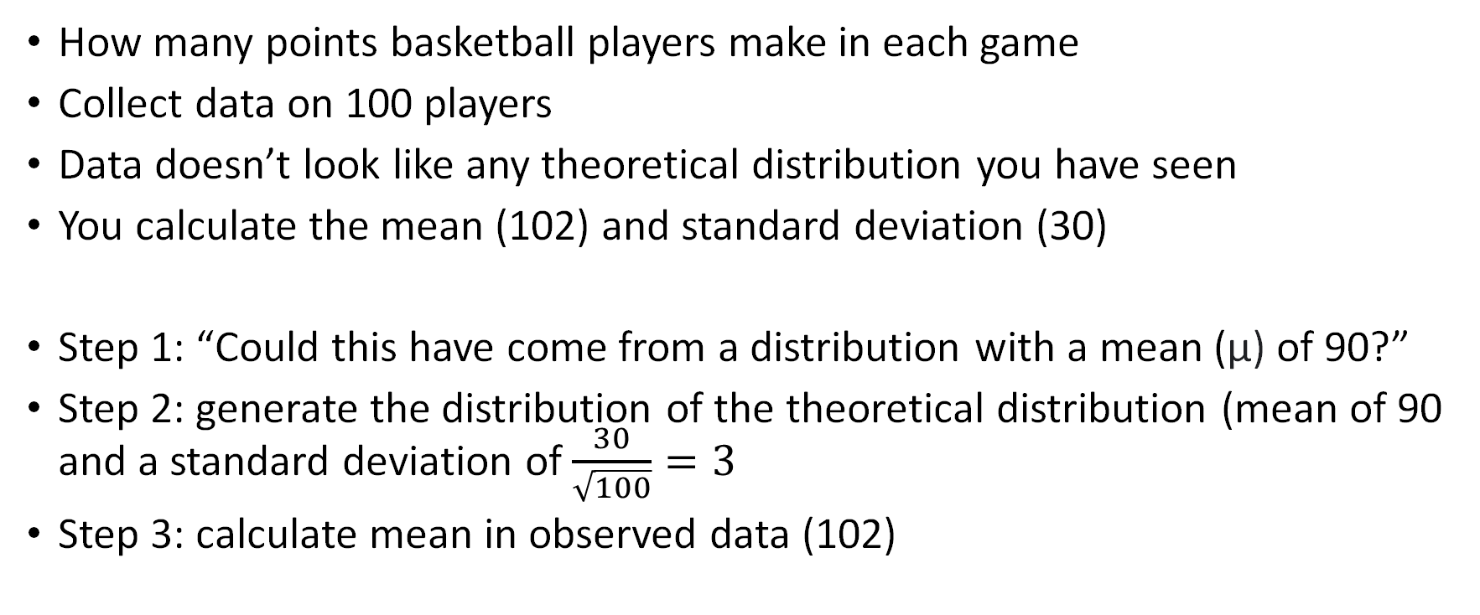
An example by Nick Huntington-Klein
How many points basketball players make in each game
Collect data on 100 players
Data doesn’t look like any theoretical distribution you have seen
You calculate the mean (102) and standard deviation (30)
Step 1: “Could this have come from a distribution with a mean (µ) of 90?”
Step 2: generate the distribution of the theoretical distribution (mean of 90 and a standard deviation of $\frac{30}{\sqrt{100}}=3$
Step 3: calculate mean in observed data (102)
The effect: An Introduction to Research Design and Causality by Nick Huntington-Klein https://theeffectbook.net/

Slide 10
An example by Nick Huntington-Klein
Step 4: “how likely is it to get a 102 or even more from a normal distribution with mean 90 and standard deviation of 3?”
How likely to get a mean of 102 or more or a mean of 78 or less
If we check percentiles
78 is 0.004th percentile (0.004% chance or less of getting a mean of 78 or less)
102 is 99.996th percentile (0.004% chance or less of getting a mean of 102 or more)
Step 5: add the two chances together
0.008% chance of getting a mean as far off as 102 or more if the true mean is 90 and the true standard deviation is 30
It is pretty unlikely (this data very likely did not come from a distribution with a mean of 90)
The effect: An Introduction to Research Design and Causality by Nick Huntington-Klein https://theeffectbook.net/

Slide 11
LECTURE LEARNING OUTCOMES OF EACH OF THE DIDACTIC SESSIONS
REFERENCE:
Chapter 8 in Rothman KJ. Epidemiology: an introduction. Oxford university press; 2012 May 4
Chapter 15 in Modern Epidemiology 4th edition
P. 22-28 of Chapter 2 in Modern Epidemiology 4th edition
LECTURE LEARNING OUTCOMES:
Describe the different statistical paradigms.
Explain the p-value.
Explain the confidence interval.

Slide 12
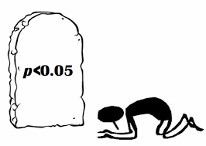
https://emcrit.org/pulmcrit/demystifying-the-p-value/

Slide 13
High sugar consumption group had 1.2 times the risk of developing dental caries compared to low sugar consumption group (p=0.03)

Slide 14
Probability that high sugar consumption causes caries?
Probability that high sugar consumption causes caries is true?
Probability that high sugar consumption causes caries is false?
Probability that high sugar consumption does not causes caries?
Probability that high sugar consumption does not causes caries is true?
Probability that high sugar consumption does not causes caries is false?
Probability of chance?
Else?

Slide 15
Probability of hypothesis given (assuming) data?
Probability of data given (assuming) hypothesis?

Slide 16
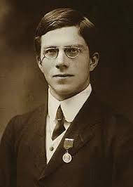
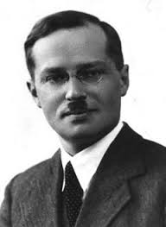
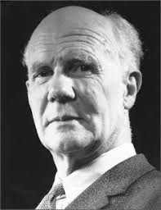

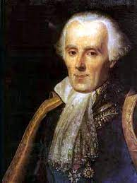
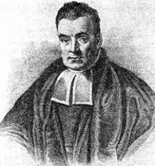
Statistical paradigms
Frequentists
Bayesians
Likelihoodists
RA Fisher
Significance tests
Jerzey Neyman / Egon Pearson
Null hypothesis significance tests
Leplace Thomas Bayes
Richard Royall
Probability of data given (assuming) hypothesis
Probability of hypothesis given (assuming) data

Slide 17
A statistical test
Hypothesis
A claim about some aspect of the process that might have given rise to data x=(x₁, x₂, ……, x_{n}), given in a model of that process
Assign probabilities of different outcomes x assuming the hypothesis is true
Distance function and its distribution
A function of the sample d(x)
A test statistic that reflects fit or misfit of data x with the hypothesis
Distribution of test statistic can be computed assuming the hypothesis is true
Test rule
Interpretative or methodological rule for inference
E.g., data (x) is evidence of a discrepancy δ from the hypothesis when d(x)≥ c, for some value of c
Probability that {d(x)≥ c} assuming the hypothesis is true can be calculated
c
Mayo DG. Statistical inference as severe testing. Cambridge: Cambridge University Press; 2018.

Slide 18
c
c
c
c

Slide 19
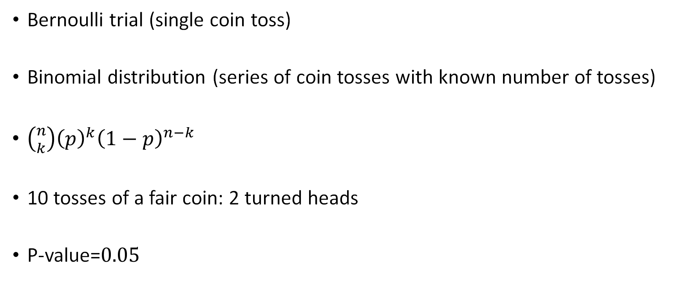
Example of a coin toss
Bernoulli trial (single coin toss)
Binomial distribution (series of coin tosses with known number of tosses)
$\left({n \atop k}\right){\left(p\right)}^{k}{\left(1−p\right)}^{n−k}$
10 tosses of a fair coin: 2 turned heads
P-value=$0.05$

Slide 20
Definition of the p-value
Probability of observing the data or more extreme assuming the test hypothesis (often being the null hypothesis) is true
RA Fisher

Slide 21
Explain p-value in our example
Probability of observing 2 heads or more extreme (i.e., less than 2 heads) assuming the test hypothesis (i.e., the coin is fair) is true
Probability of observing 2 heads or less assuming the coin is fair

Slide 22
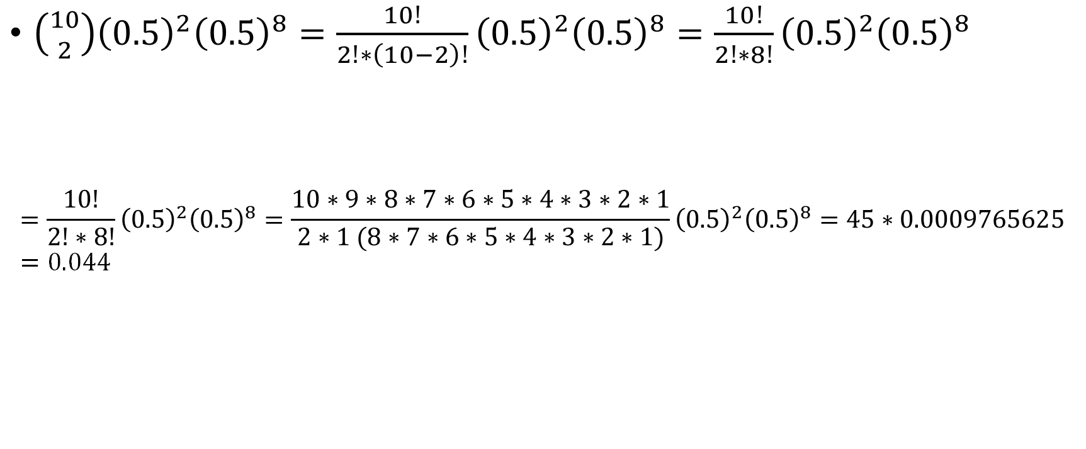
How to calculate probability of 2 heads out of 10
$\left({10 \atop 2}\right){\left(0.5\right)}^{2}{\left(0.5\right)}^{8}=\frac{10!}{2!∗\left(10−2\right)!}{\left(0.5\right)}^{2}{\left(0.5\right)}^{8}=\frac{10!}{2!∗8!}{\left(0.5\right)}^{2}{\left(0.5\right)}^{8}$
$$=\frac{10!}{2!∗8!}{\left(0.5\right)}^{2}{\left(0.5\right)}^{8}=\frac{10∗9∗8∗7∗6∗5∗4∗3∗2∗1}{2∗1 (8∗7∗6∗5∗4∗3∗2∗1)}{\left(0.5\right)}^{2}{\left(0.5\right)}^{8}=45∗0.0009765625=0.044$$

Slide 23
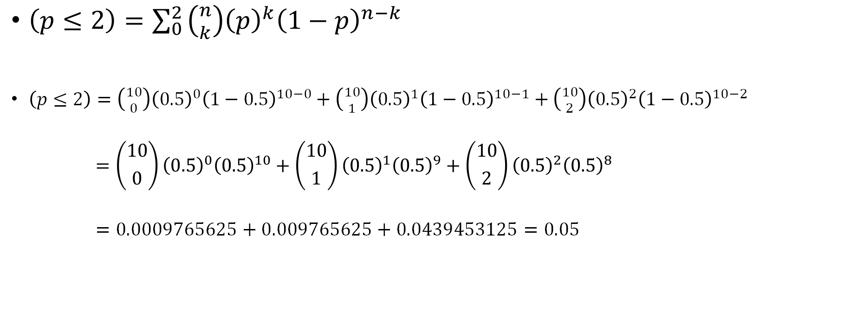
How to calculate p-value in example
$\left(p≤2\right)=\sum_{0}^{2 }{\left({n \atop k}\right){\left(p\right)}^{k}{\left(1−p\right)}^{n−k}}$
$\left(p≤2\right)=\left({10 \atop 0}\right){\left(0.5\right)}^{0}{\left(1−0.5\right)}^{10−0}+\left({10 \atop 1}\right){\left(0.5\right)}^{1}{\left(1−0.5\right)}^{10−1}+\left({10 \atop 2}\right){\left(0.5\right)}^{2}{\left(1−0.5\right)}^{10−2}$
$$=\left({10 \atop 0}\right){\left(0.5\right)}^{0}{\left(0.5\right)}^{10}+\left({10 \atop 1}\right){\left(0.5\right)}^{1}{\left(0.5\right)}^{9}+\left({10 \atop 2}\right){\left(0.5\right)}^{2}{\left(0.5\right)}^{8}$$
$$=0.0009765625+0.009765625+0.0439453125=0.05$$

Slide 24
A statistical test
Hypothesis (coin is fair, from which we can compute probability of getting heads=0.5)
A claim about some aspect of the process that might have given rise to data x=(x₁, x₂, ……, x_{n}), given in a model of that process
Assign probabilities of different outcomes x assuming the hypothesis is true
Distance function and its distribution (test statistic being number of heads in N tosses)
A function of the sample d(x)
A test statistic that reflects fit or misfit of data x with the hypothesis
Distribution of test statistic can be computed assuming the hypothesis is true
Test rule (e.g., if number of heads observed ≥ certain number of heads)
Interpretative or methodological rule for inference
E.g., data (x) is evidence of a discrepancy δ from the hypothesis when d(x)≥ c, for some value of c
Probability that {d(x)≥ c} assuming the hypothesis is true can be calculated
Mayo DG. Statistical inference as severe testing. Cambridge: Cambridge University Press; 2018.

Slide 25
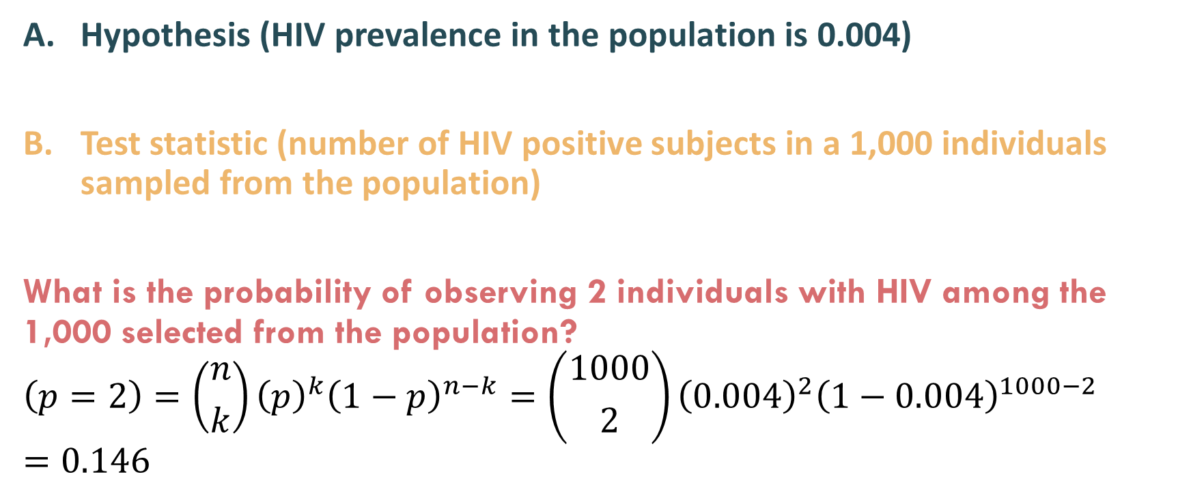
Another example of statistical test within context of HIV By Ken Rothman
Hypothesis (HIV prevalence in the population is 0.004)
Test statistic (number of HIV positive subjects in a 1,000 individuals sampled from the population)
What is the probability of observing 2 individuals with HIV among the 1,000 selected from the population?
$$\left(p=2\right)=\left({n \atop k}\right){\left(p\right)}^{k}{\left(1−p\right)}^{n−k}=\left({1000 \atop 2}\right){\left(0.004\right)}^{2}{\left(1−0.004\right)}^{1000−2}=0.146$$
Rothman KJ, Greenland S, Lash TL. Modern epidemiology. Philadelphia: Wolters Kluwer Health/Lippincott Williams & Wilkins; 2008 Sep 20.

Slide 26
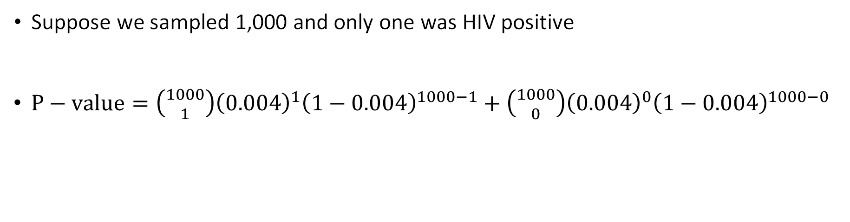
Another example of statistical test within context of HIV By Ken Rothman
Suppose we sampled 1,000 and only one was HIV positive
$P−value=\left({1000 \atop 1}\right){\left(0.004\right)}^{1}{\left(1−0.004\right)}^{1000−1}+\left({1000 \atop 0}\right){\left(0.004\right)}^{0}{\left(1−0.004\right)}^{1000−0}$
Probability of observing 1 HIV+ individual or more extreme (i.e., less) in the sample assuming that HIV prevalence in the population is 0.004
Rothman KJ, Greenland S, Lash TL. Modern epidemiology. Philadelphia: Wolters Kluwer Health/Lippincott Williams & Wilkins; 2008 Sep 20.

Slide 27
P-values describe compatibility of data with the null hypothesis
Range from 0-1 (continuous measure)
0=results (Data) impossible assuming null hypothesis is true
1=results perfectly compatible assuming null is true
Null hypothesis significance testing (NHST): dichotomize the p-value
< 0.05 (reject the null hypothesis)
≥ 0.05 (failing to reject the null hypothesis)

Slide 28
Let’s try an experiment
Each should toss a coin 10 times and see how many heads you get

Slide 29
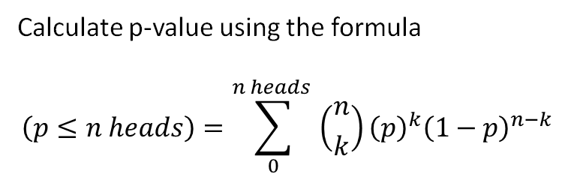
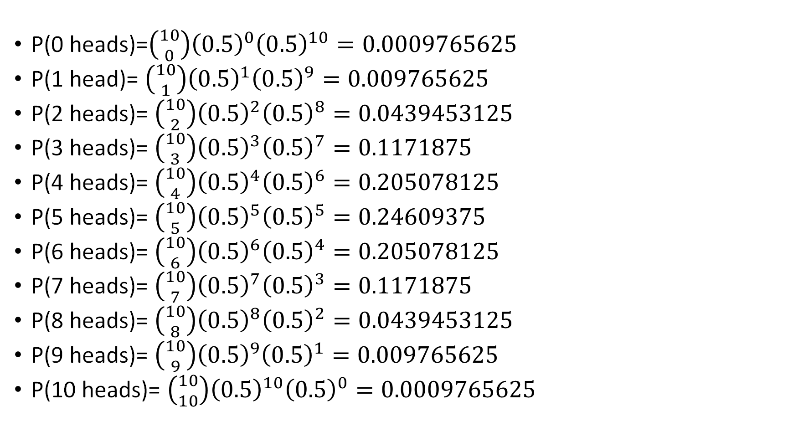
Calculate p-value using the formula
$$\left(p≤n heads\right)=\sum_{0}^{n heads }{\left({n \atop k}\right){\left(p\right)}^{k}{\left(1−p\right)}^{n−k}}$$
P(0 heads)=$\left({10 \atop 0}\right){\left(0.5\right)}^{0}{\left(0.5\right)}^{10}=0.0009765625$
P(1 head)= $\left({10 \atop 1}\right){\left(0.5\right)}^{1}{\left(0.5\right)}^{9}=0.009765625$
P(2 heads)= $\left({10 \atop 2}\right){\left(0.5\right)}^{2}{\left(0.5\right)}^{8}=0.0439453125$
P(3 heads)= $\left({10 \atop 3}\right){\left(0.5\right)}^{3}{\left(0.5\right)}^{7}=0.1171875$
P(4 heads)= $\left({10 \atop 4}\right){\left(0.5\right)}^{4}{\left(0.5\right)}^{6}=0.205078125$
P(5 heads)= $\left({10 \atop 5}\right){\left(0.5\right)}^{5}{\left(0.5\right)}^{5}=0.24609375$
P(6 heads)= $\left({10 \atop 6}\right){\left(0.5\right)}^{6}{\left(0.5\right)}^{4}=0.205078125$
P(7 heads)= $\left({10 \atop 7}\right){\left(0.5\right)}^{7}{\left(0.5\right)}^{3}=0.1171875$
P(8 heads)= $\left({10 \atop 8}\right){\left(0.5\right)}^{8}{\left(0.5\right)}^{2}=0.0439453125$
P(9 heads)= $\left({10 \atop 9}\right){\left(0.5\right)}^{9}{\left(0.5\right)}^{1}=0.009765625$
P(10 heads)= $\left({10 \atop 10}\right){\left(0.5\right)}^{10}{\left(0.5\right)}^{0}=0.0009765625$
1

Slide 30
How come the p-value differed with each experiment?
Dance of the p-values (by psychologist Cumming)
The p-value is random and has a distribution if we repeat the experiment many times (infinitely large number of repetitions)

Slide 31
Example
Let’s look at the effect of fluoride on caries
Null hypothesis: fluoride has no effect on caries
We do the same study investigating the effect of fluoride on caries many times and look at the distribution of the p-values

Slide 32
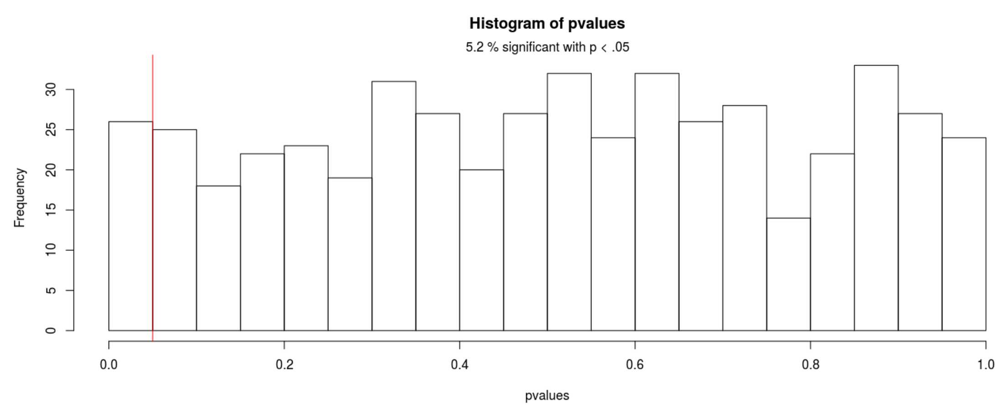
Explanation of distribution of the p-value if the null was true (fluoride has no effect on caries)
Uniform distribution

Slide 33
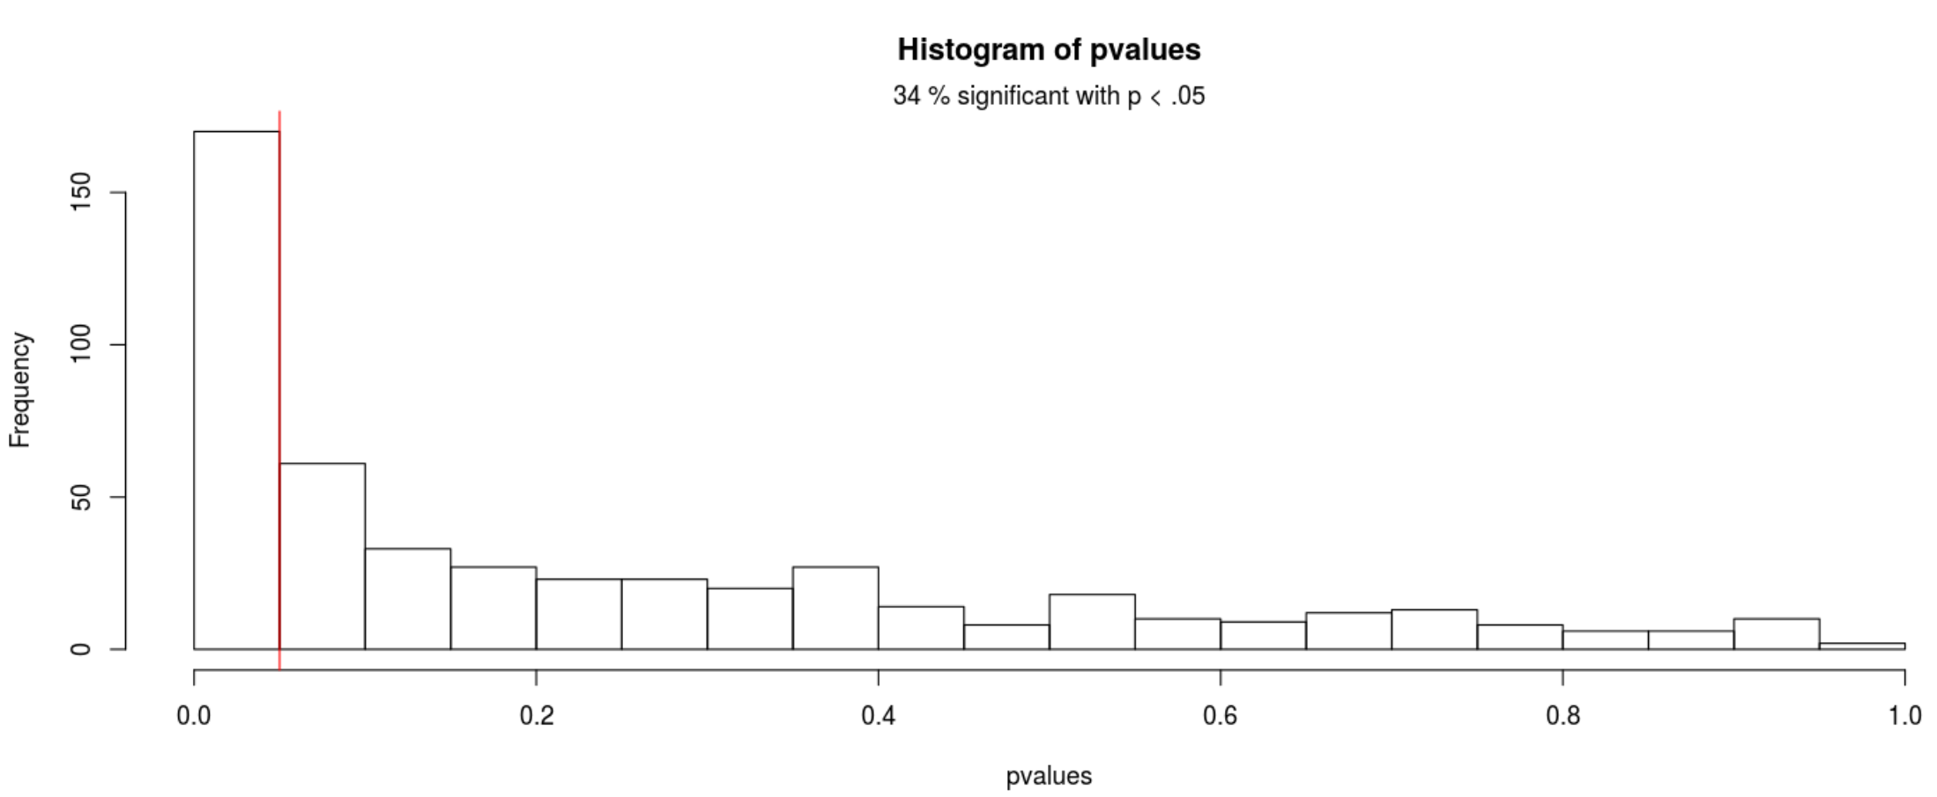
Explanation of distribution of the p-value if the null was false (fluoride has an effect on caries)
Skewed distribution to the right

Slide 34
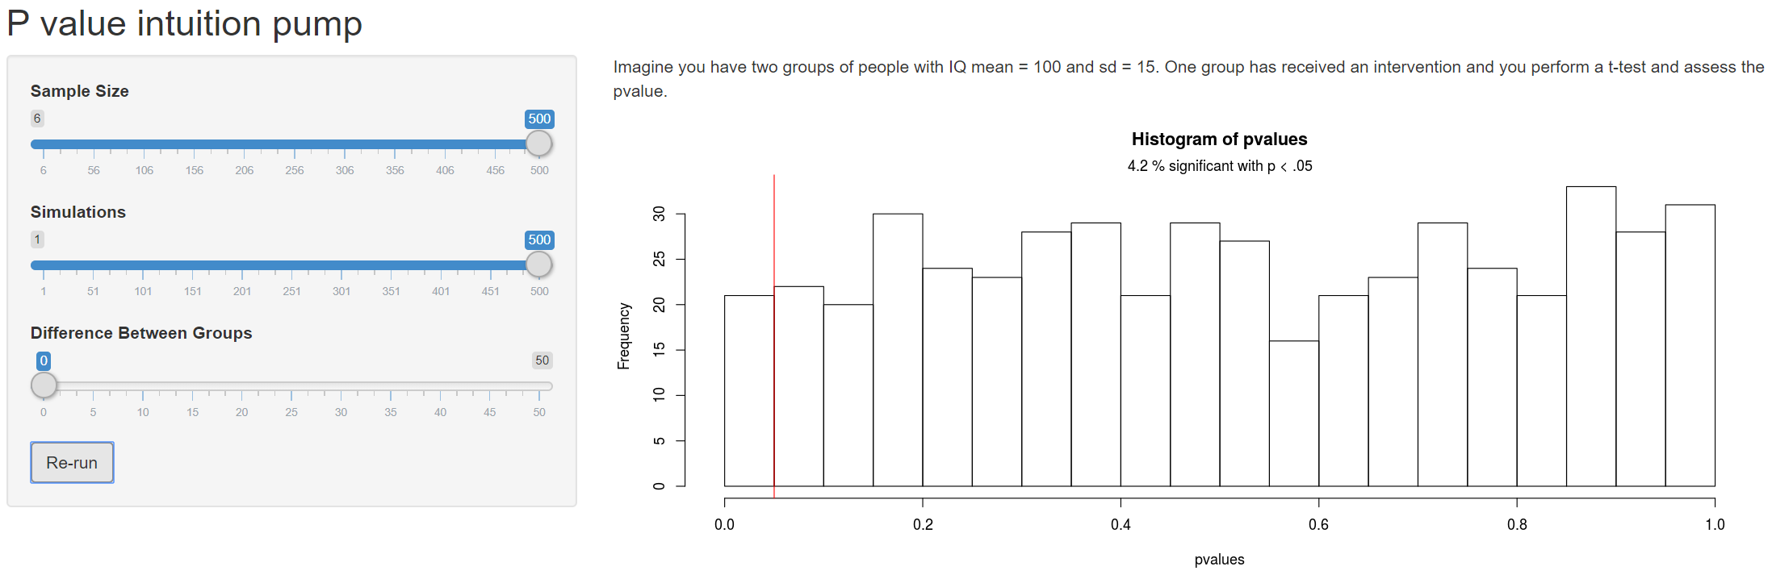
Test this
https://magnusnordmo.shinyapps.io/pvalue/

Slide 35
Explanation of null hypothesis significance testing (NHST)
 | Null hypothesis is true | Null hypothesis is false
Reject the null (significant finding) | False positive | True positive
Fail to reject the null (non-significant finding) | True negative | False negative

Slide 36
Explanation of type 1 (α) error rate
Probability of a significant result when the null hypothesis is true
Number of times we would wrongly reject the null hypothesis out of infinitely large number of repetitions if the null hypothesis is true
 | Null hypothesis is true | Null hypothesis is false
Reject the null (significant finding) | False positive (α) | True positive
Fail to reject the null (non-significant finding) | True negative | False negative

Slide 37
Explanation of type 2 (β) error rate
Probability of a non-significant result when the null hypothesis is false
Number of times we would wrongly fail to reject the null hypothesis out of infinitely large number of repetitions if the null hypothesis is false
 | Null hypothesis is true | Null hypothesis is false
Reject the null (significant finding) | False positive | True positive
Fail to reject the null (non-significant finding) | True negative | False negative (β)

Slide 38
Explanation of statistical power (1-β)
Probability of a significant result when the null hypothesis is false
Number of times we would correctly reject the null hypothesis out of infinitely large number of repetitions if the null hypothesis is false
 | Null hypothesis is true | Null hypothesis is false
Reject the null (significant finding) | False positive | True positive (1-β)
Fail to reject the null (non-significant finding) | True negative | False negative

Slide 39
Summary
 | Null hypothesis is true | Null hypothesis is false
Reject the null (significant finding) | False positive (α) | True positive (1-β)
Fail to reject the null (non-significant finding) | True negative | False negative (β)

Slide 40
Example
We believe that null hypothesis is equally likely to be true or false
 | Null hypothesis is true | Null hypothesis is false | Total
Reject the null (significant finding) | 100 | 400
Fail to reject the null (non-significant finding) | 400 | 100
Total | (50%)=500 | (50%)=500 | 1,000
Type 1 error rate=100/500=20%
Type 2 error rate=100/500=20%
Power=1-type 2 error rate=400/500=80%

Slide 41
Example
We believe that null hypothesis is more likely to be true than false
 | Null hypothesis is true | Null hypothesis is false | Total
Reject the null (significant finding) | 100 | 100
Fail to reject the null (non-significant finding) | 700 | 100
Total | (80%)=800 | (20%)=200 | 1,000
Type 1 error rate=100/800=12.5%
Type 2 error rate=100/200=50%
Power=1-type 2 error rate=100/200=50%

Slide 42
Explanation of null hypothesis significance testing (NHST)
For decision making based on infinitely large number of repetitions of the same experiment
Works well in industrial setting (e.g., manufacturing)

Slide 43
Definition of p-value revisited
Probability of observing the data or more extreme assuming the entire model is true
Assuming the entire model is true:
Test hypothesis (often being the null) is true
Auxiliary assumptions
Randomization/random sample
No confounding
No measurement error
No selection bias
No p-hacking
No hypothesizing after results are known (HARKING)
No fraud
Functional form is true

Slide 44
A statistical test
Hypothesis
A claim about some aspect of the process that might have given rise to data x=(x₁, x₂, ……, x_{n}), given in a model of that process
Assign probabilities of different outcomes x assuming the hypothesis is true
Distance function and its distribution
A function of the sample d(x)
A test statistic that reflects fit or misfit of data x with the hypothesis
Distribution of test statistic can be computed assuming the hypothesis is true
Test rule
Interpretative or methodological rule for inference
E.g., data (x) is evidence of a discrepancy δ from the hypothesis when d(x)≥ c, for some value of c
Probability that {d(x)≥ c} assuming the hypothesis is true can be calculated
c
Mayo DG. Statistical inference as severe testing. Cambridge: Cambridge University Press; 2018.

Slide 45
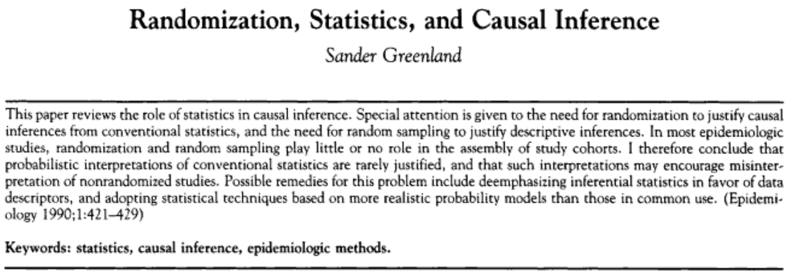

Slide 46
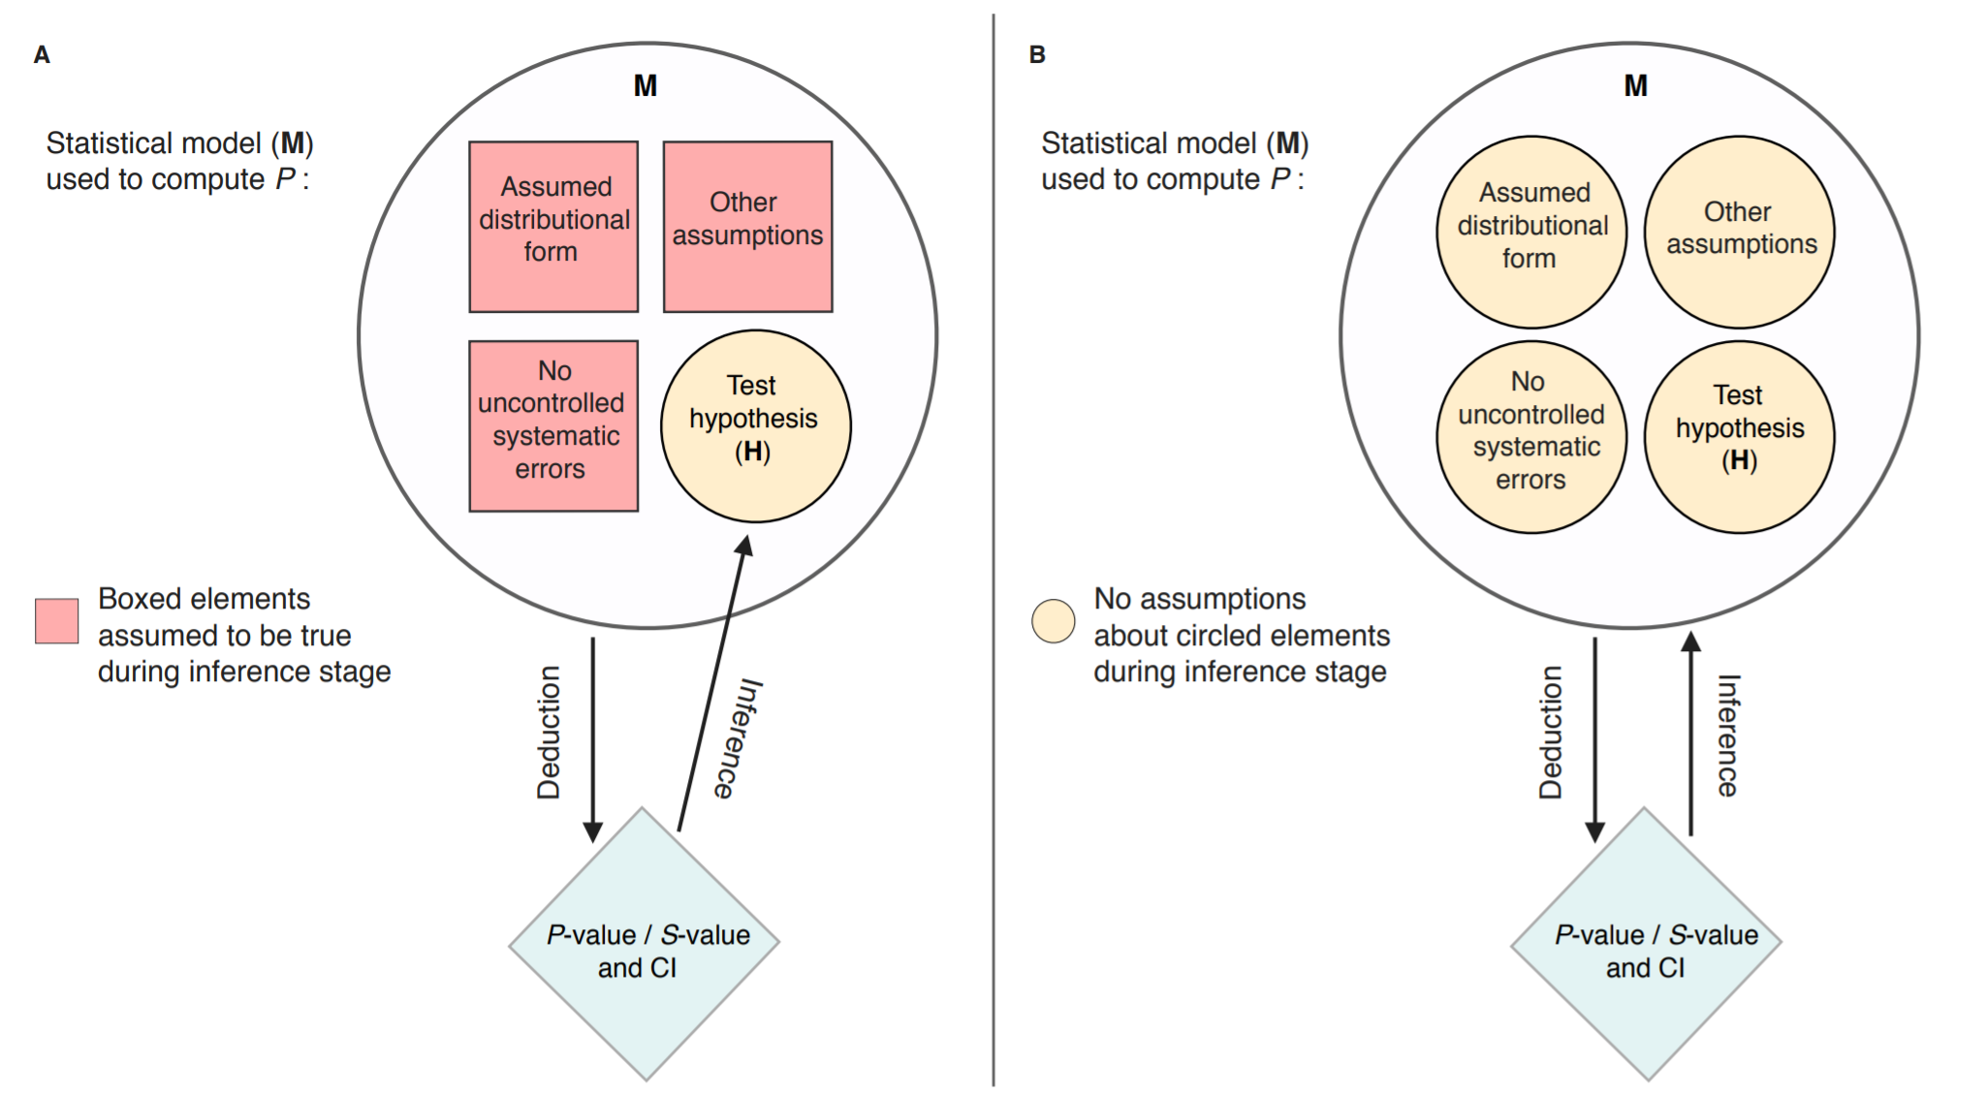
Greenland S, Chow ZR. To aid statistical inference, emphasize unconditional descriptions of statistics. arXiv preprint arXiv:1909.08583. 2019 Sep 18.

Slide 47
In our coin toss example
Probability of observing 2 heads or more extreme (i.e., less than 2) assuming:
The coin is fair
Tossed by the same person
The coin is tossed each time with the same speed
The coin is tossed with the same initial side
The coin does not hit any object mid air
The person does not cheat in tossing
The person did not selectively discard some tosses
Etc.

Slide 48
Describe compatibility of p-value with the entire model
Assuming the entire model is true:
Test hypothesis (often being the null) is true
Auxiliary assumptions
Randomization/random sample
No confounding
No measurement error
No selection bias
No p-hacking
No hypothesizing after results are known (HARKING)
No fraud
Functional form is true
Range from 0-1
0=results impossible assuming the entire model is true
1=results perfectly compatible assuming the entire model is true
Null hypothesis significance testing (NHST)
< 0.05 (reject the model)
≥ 0.05 (failing to reject the model)

Slide 49
When we reject the entire model (significant result)
Test hypothesis (often being the null) is true
Auxiliary assumptions
Randomization/random sample
No confounding
No measurement error
No selection bias
No p-hacking
No hypothesizing after results are known (HARKING)
No fraud
Functional form is true
At least one assumption is wrong

Slide 50
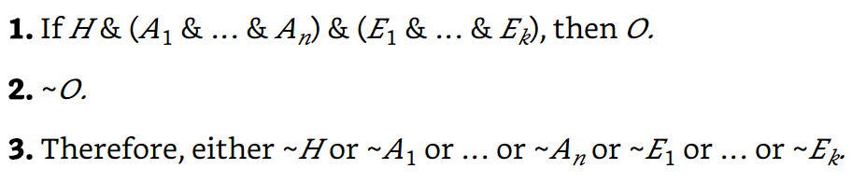
Deductive falsification argument
Auxiliary factors linking substantive and statistical claims
Hypothesis of interest
Assumptions of the statistical model
Observation/data
Modus tollens
Mayo DG. Statistical inference as severe testing. Cambridge: Cambridge University Press; 2018.

Slide 51
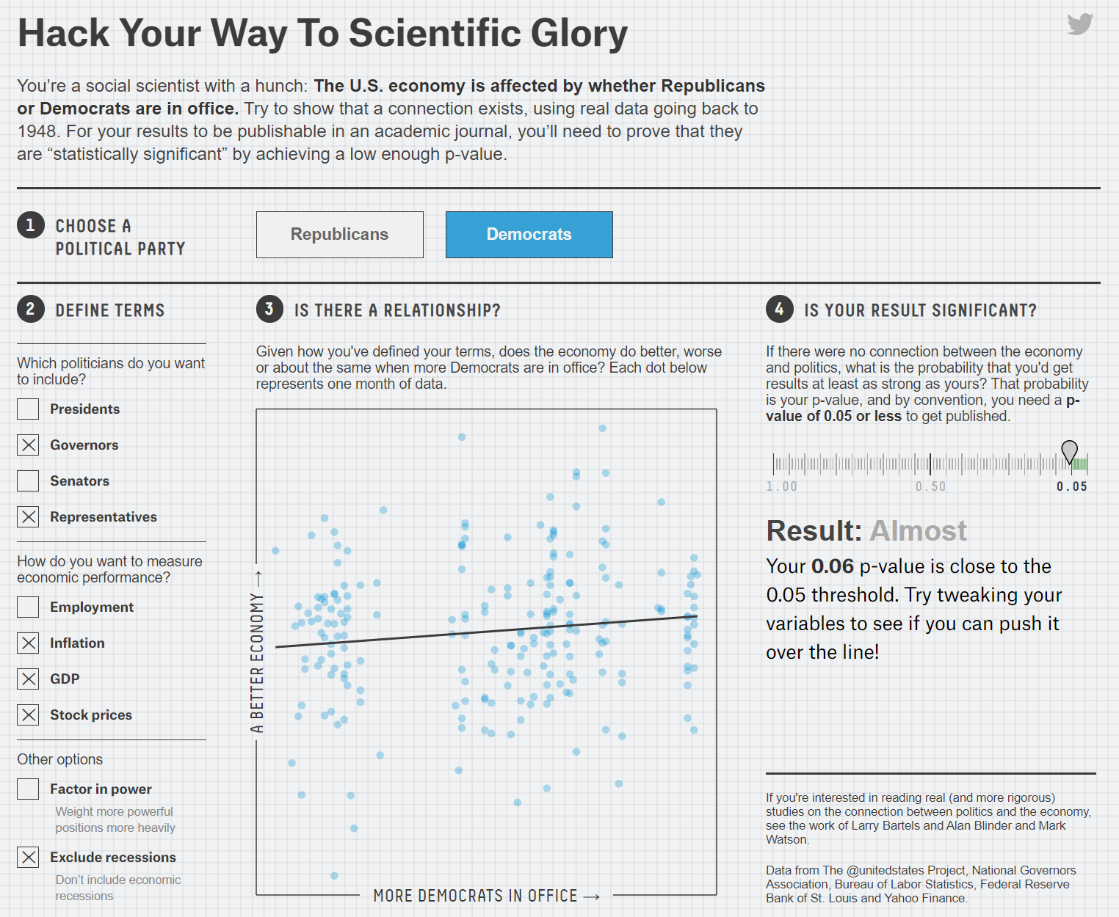
https://projects.fivethirtyeight.com/p-hacking/

Slide 52
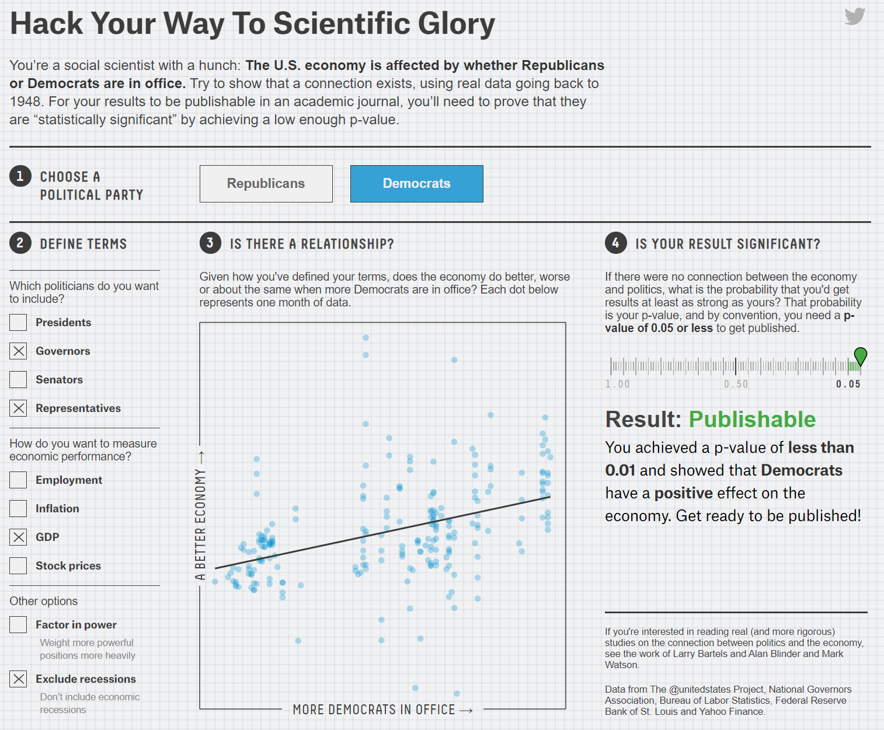
https://projects.fivethirtyeight.com/p-hacking/

Slide 53
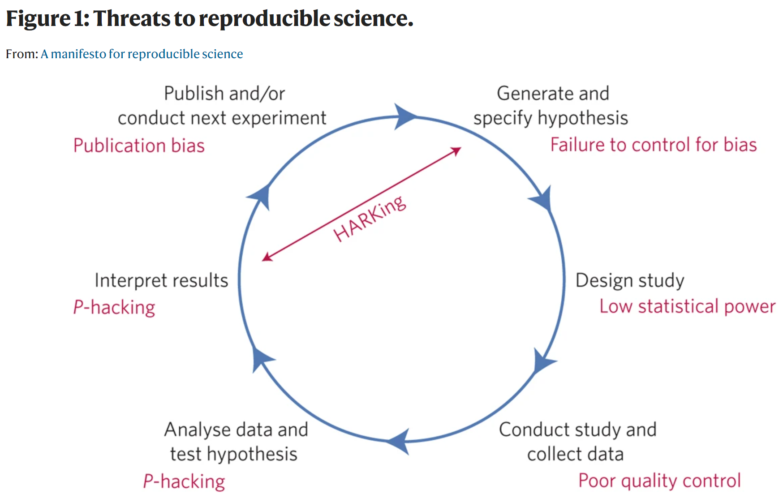
MUNAFÒ, Marcus R., et al. A manifesto for reproducible science. Nature human behaviour, 2017, 1.1: 1-9.‏

Slide 54
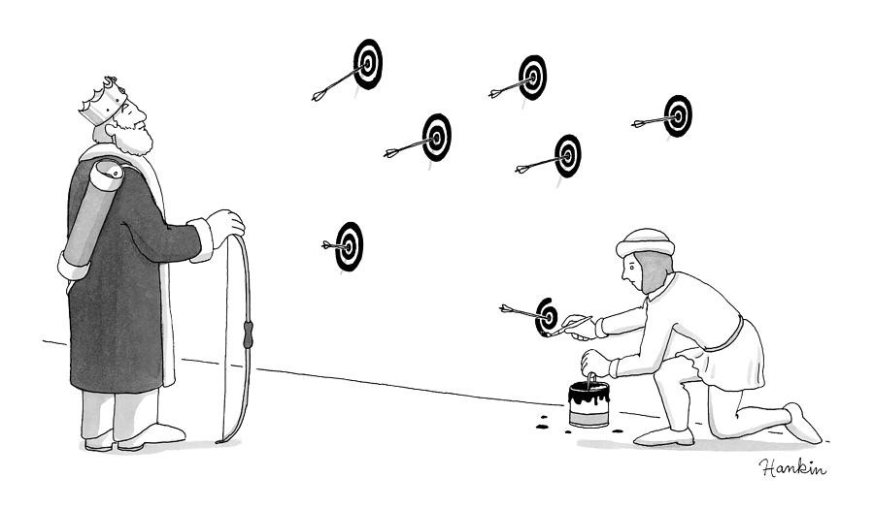
https://fineartamerica.com/featured/a-young-assistant-to-the-king-paints-bullseyes-charlie-hankin.html

Slide 55
Common misinterpretations of p-values
Probability of observing the result due to chance and chance alone
Probability of chance is 100% (results are entirely based on chance)
Probability of the null hypothesis being true
We are already calculating the p-value assuming the null hypothesis is true
Probability of the false-positive
Probability of false positive depends on many repetitions of the same experiments
Once you do the study: the probability that study being false-positive is either 0 or 1
Greenland S, Senn SJ, Rothman KJ, Carlin JB, Poole C, Goodman SN, Altman DG. Statistical tests, P values, confidence intervals, and power: a guide to misinterpretations. European journal of epidemiology. 2016 Apr 1;31(4):337-50.

Slide 56
95% Confidence intervals
If data on age of the COD students is collected and the mean and standard deviation are known to the administration
I ask one of you to randomly select 5 student and calculate their mean age, standard deviation and 95% confidence interval got a mean of 24 (95% 22-26)
What does this mean?

Slide 57
A property of a confidence procedure and not a single study
If we repeat selection of 5 students and calculate their mean age, standard deviation and 95% CI infinitely large number of times
Then the confidence intervals of these large repetitions would include the true mean age of COD students 95% of the times
Inspired by examples in
Gelman A, Nolan D. Teaching statistics: A bag of tricks. Oxford University Press; 2017 May 4.

Slide 58
1st
2nd
3rd
4th
5th
6th
7th
8th
9th
10th
11th
12th
13th
14th
15th
16th
17th
18th
19th
20th
True mean
20
21
22
23
24
25
26
27
28
29
Inspired by examples in
Gelman A, Nolan D. Teaching statistics: A bag of tricks. Oxford University Press; 2017 May 4.

Slide 59
A property of a confidence procedure and not a single study
Each study before it happens (i.e., that is before data collection) has a 95% probability of its confidence interval including the true mean age
but once data collection takes place and the 95% is calculated then that specific interval either includes the true mean age or not (probability is either 0 or 1)

Slide 60
1st
1
2nd
1
3rd
0
4th
1
5th
1
6th
1
7th
1
8th
1
9th
1
10th
1
11th
1
12th
1
13th
1
14th
1
15th
1
16th
1
17th
1
18th
1
19th
1
20th
1
True mean
20
21
22
23
24
25
26
27
28
29

Slide 61
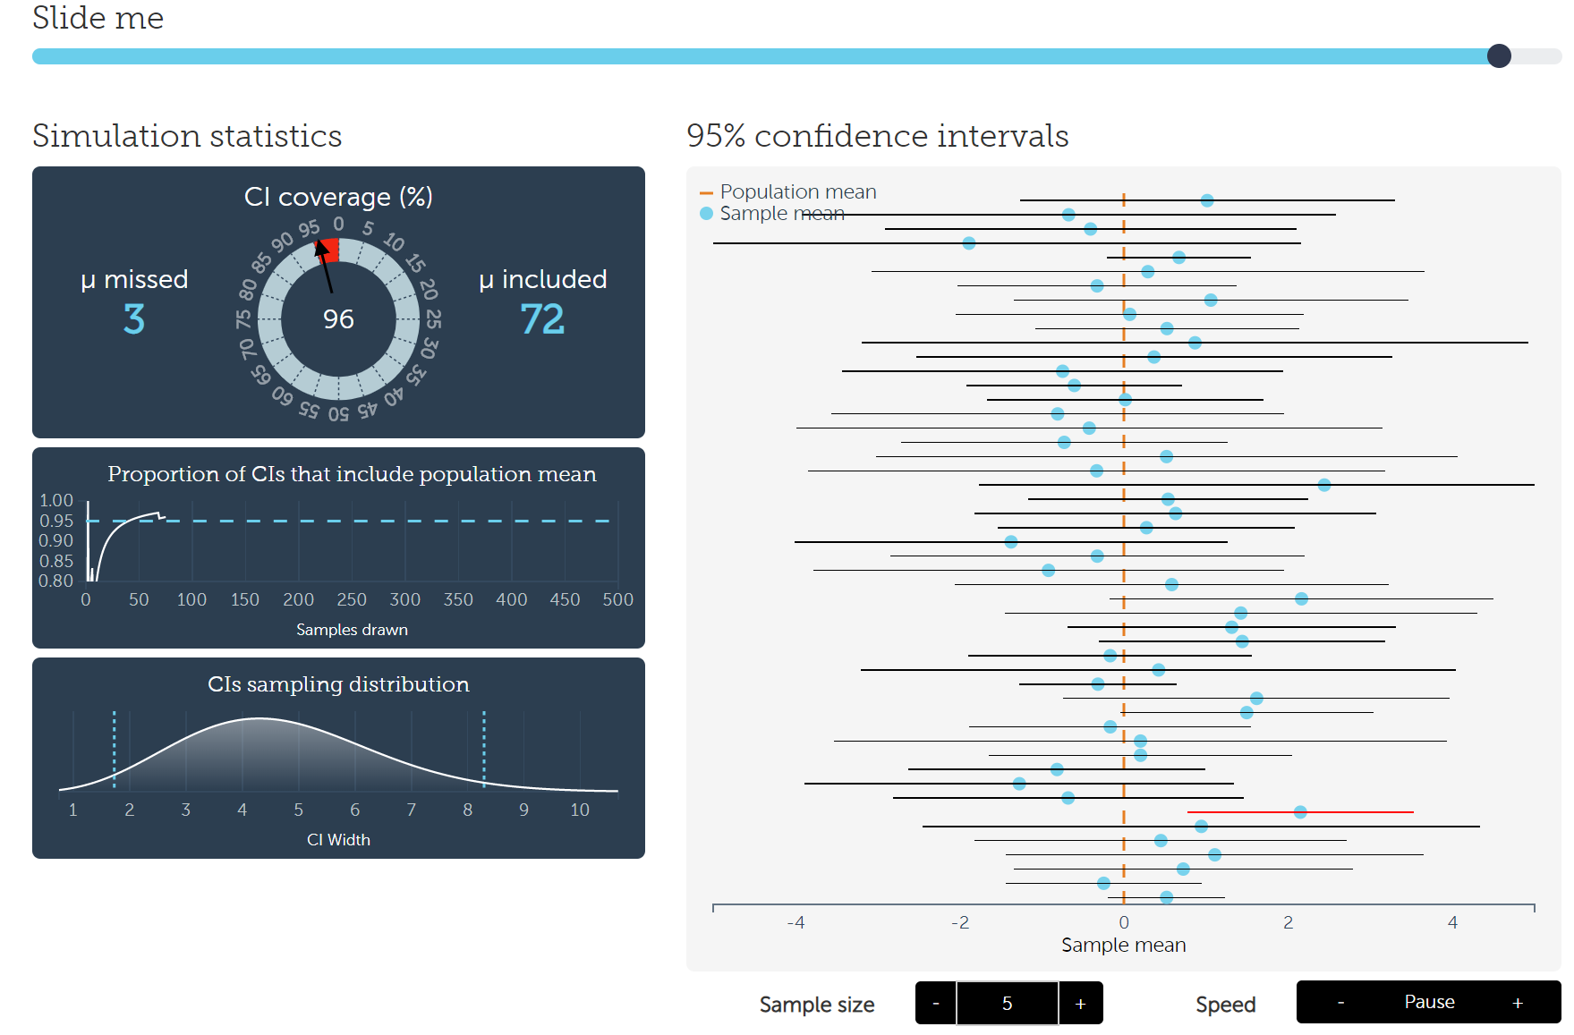
Test this
https://rpsychologist.com/d3/CI/

Slide 62
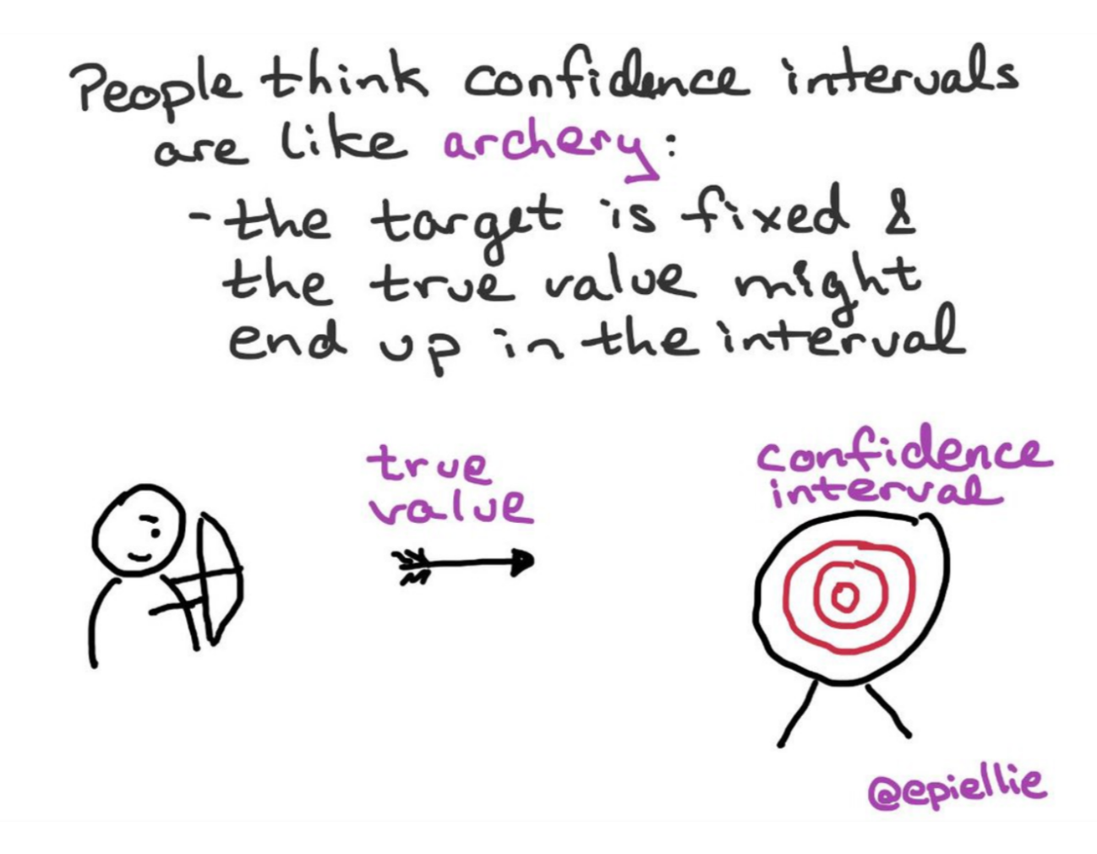
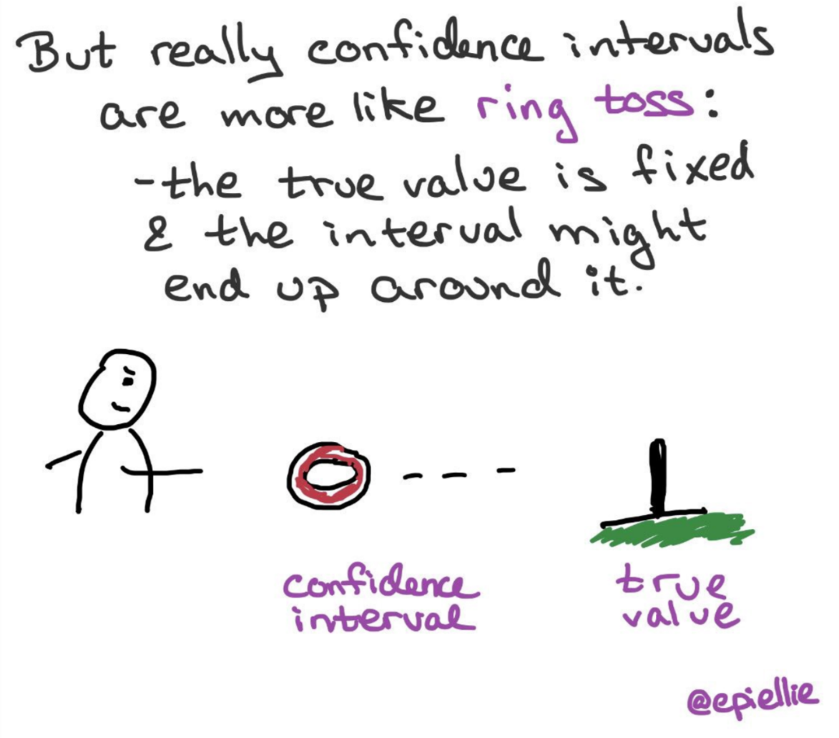
https://twitter.com/EpiEllie/status/1073385394580979712
https://medium.com/@EpiEllie

Slide 63
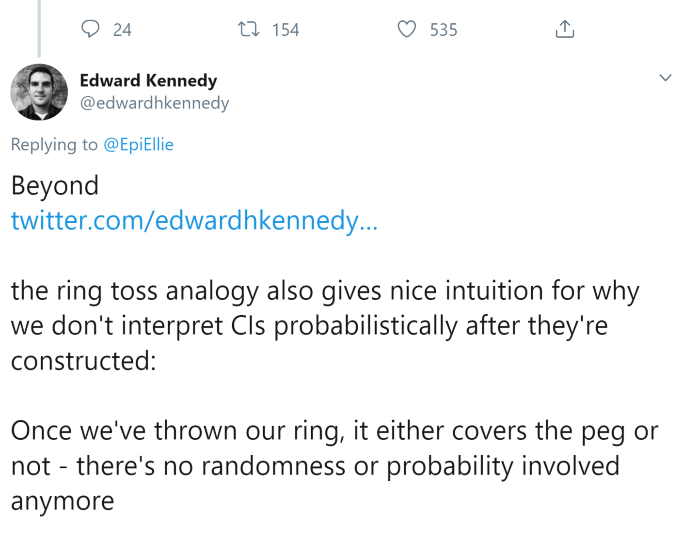

https://twitter.com/edwardhkennedy/status/1177290538095140864

Slide 64
How to interpret a 95% CI from a study?

Slide 65
Relation between p-values and 95% CI
Alpha=0.05 corresponding confidence level will be 95%
Alpha=0.01 corresponding confidence level will be 99%
Alpha=0.1 corresponding confidence level will be 90%
Confidence level=1-alpha selected for p-value (commonly 0.05)

Slide 66
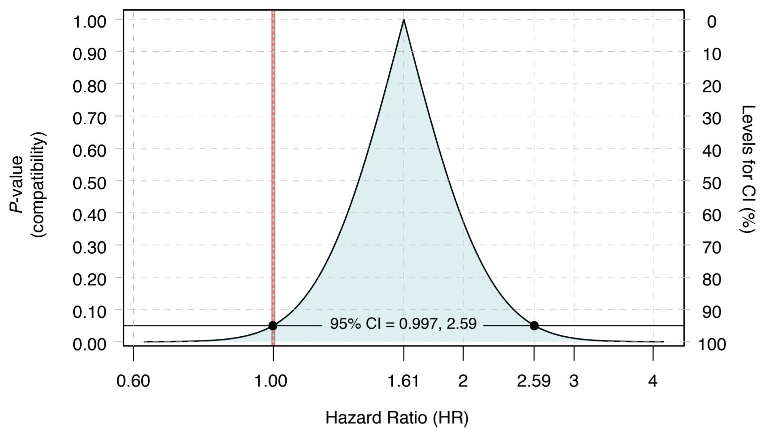
Chow ZR, Greenland S. Semantic and Cognitive Tools to Aid Statistical Inference: Replace Confidence and Significance by Compatibility and Surprise. arXiv preprint arXiv:1909.08579. 2019 Sep 18.

Slide 67
Interpretation of single 95% CI
In the example of mean age 24 (95% 22-26)
The set of values in which the probability of observing them or more extreme assuming the entire model is correct is ≥ 0.05 (observing these values is not rare assuming the model is correct)
The set of values in which they are more compatible with the model

Slide 68
Interpretation of single 95% CI
In the example of mean age 24 (95% 22-26)
A series of significance tests:
P-value of 22 ≥ 0.05
P-value of 23 ≥ 0.05
P-value of 24 ≥ 0.05
P-value of 25 ≥ 0.05
P-value of 26 ≥ 0.05
Probability of observing values or more extreme outside the interval assuming the model is correct is < 0.05 (observing these values is rare assuming the model is correct)
Notes:
It follows that a point is inside the two-sided 90% confidence interval if and only if both its lower and upper P-values are greater than 0.10/2 = 0.05. Similarly, a point is inside the two-sided 95% confidence interval if and only if both its lower and upper P-values are greater than 0.05/2 = 0.025. Indeed, these conditions are equivalent to the definitions of 90% and 95% confidence intervals.
Rothman, Kenneth J.. Modern Epidemiology (p. 221). Lippincot (Wolters Kluwer Health). Kindle Edition.

Slide 69
95% CI as an alternative (surrogate) significance tests
RR/OR the null value (value of no difference) is 1
RR= 1.3 (95% CI 1.1-1.4)
RR= 1.2 (95% CI 0.9-1.5)
RD the null value is 0
RD=2 (95% CI 1, 3)
RD=1 (95% CI -1, 2)
Observing a ratio of 1 is rare assuming the entire model is correct
Observing a ratio of 1 is common assuming the entire model is correct
Observing a difference of 0 is rare assuming the entire model is correct
Observing a difference of 0 is common assuming the entire model is correct

Slide 70
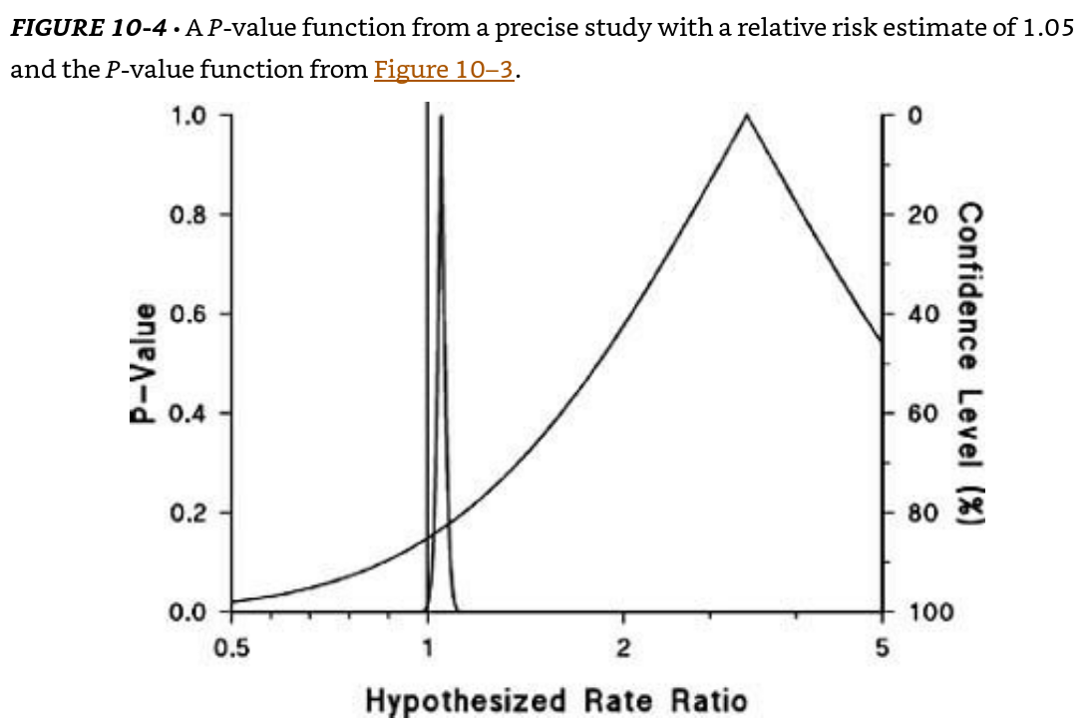
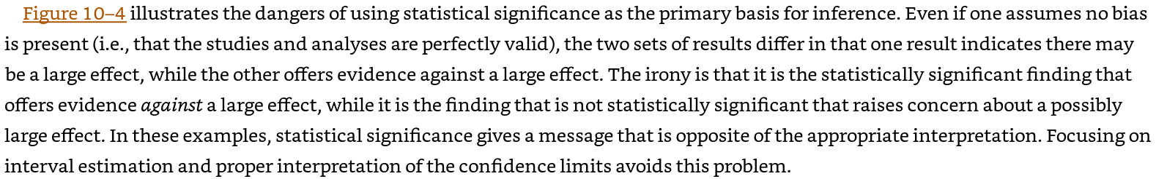
Rothman KJ, Greenland S, Lash TL. Modern epidemiology. Philadelphia: Wolters Kluwer Health/Lippincott Williams & Wilkins; 2008 Sep 20.

Slide 71
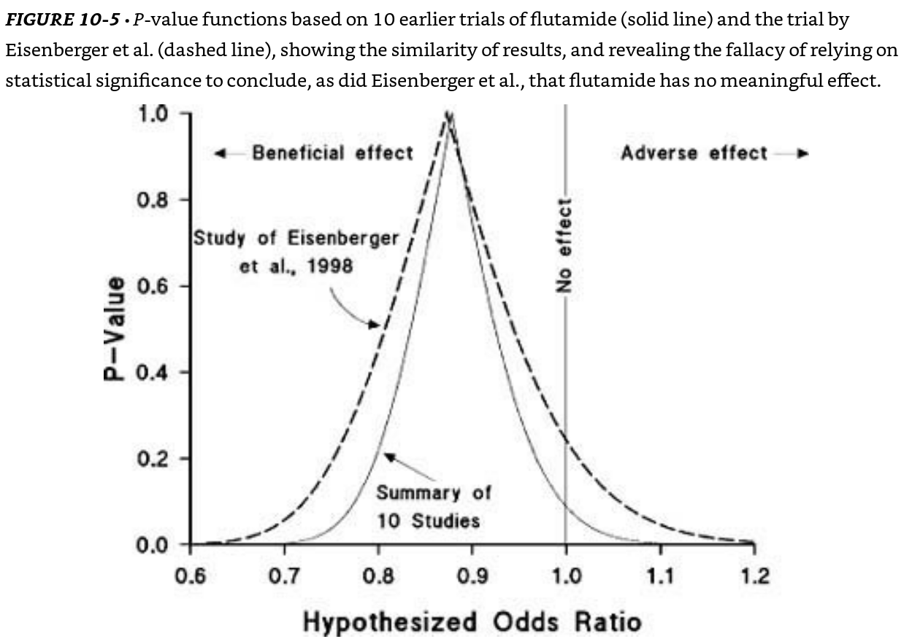
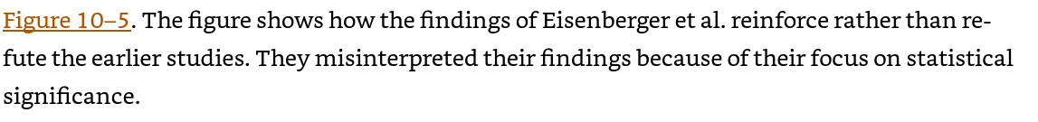
Rothman KJ, Greenland S, Lash TL. Modern epidemiology. Philadelphia: Wolters Kluwer Health/Lippincott Williams & Wilkins; 2008 Sep 20.

Slide 72
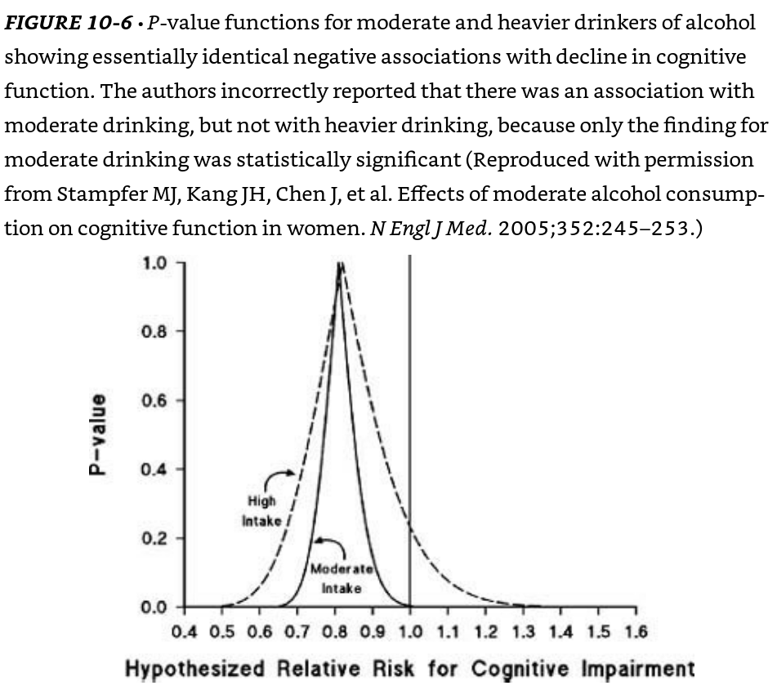
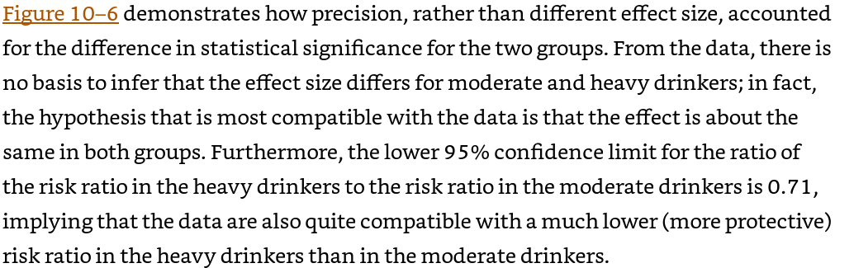
Rothman KJ, Greenland S, Lash TL. Modern epidemiology. Philadelphia: Wolters Kluwer Health/Lippincott Williams & Wilkins; 2008 Sep 20.

Slide 73
Confidence interval vs. p-values (0.80-1.50) vs. p=0.25
CI provides direction and magnitude of an association
CI provides random variability of the point estimate
P-values only provide degree of consistency between the data and a single hypothesis
No direction/magnitude
No random variability of point estimate

Slide 74

“Inferential measures such as standard errors and confidence intervals should not be used to describe the variability of characteristics, and significance tests should be avoided in descriptive tables. Also, P values are not an appropriate criterion for selecting which confounders to adjust for in analysis; even small differences in a confounder that has a strong effect on the outcome can be important.”

Slide 75
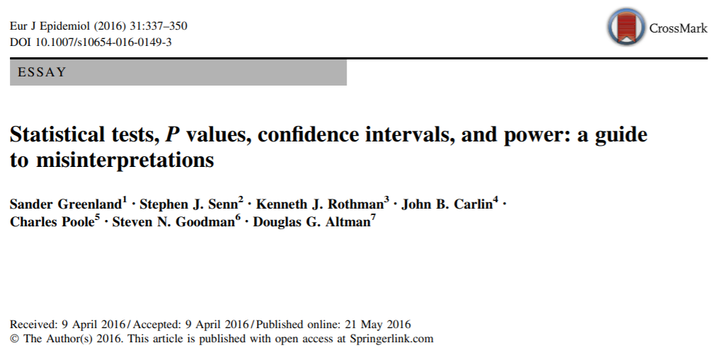

Slide 76
Take home messages
P-values has no probability meaning without randomization (it is not inferential but is descriptive in observational studies)
P-value is the probability of observing the data or more extreme assuming the entire model is correct (which includes the null hypothesis being true) (only correct interpretation)
Do not use p-values to determine what confounders you use to adjust for in your model (use prior knowledge in this matter)
Report exact p-value (p=0.01 not p<0.05 or p≥0.05) (do not dichotomize)
Do not report p-values in table 1 (even in RCTs)
Do not use confidence interval as proxy significance tests

Slide 77
Take home messages
Conduct sensitivity analysis to exclude other assumptions beside null hypothesis
Interpret single confidence intervals (from one study) as compatibility interval
Confidence interval is not the probability of the true estimate being between the lower and upper bounds of the interval)
Design Design Design
No single correct method (use multiple)
Frequentist (continuous p-value)
Bayesian
Estimation (focus on point estimates) and compatibility intervals
Others

Slide 78
References
Mayo DG. Statistical inference as severe testing. Cambridge: Cambridge University Press; 2018.
Rothman KJ, Greenland S, Lash TL. Modern epidemiology. Philadelphia: Wolters Kluwer Health/Lippincott Williams & Wilkins; 2008 Sep 20.
Greenland S, Chow ZR. To aid statistical inference, emphasize unconditional descriptions of statistics. arXiv preprint arXiv:1909.08583. 2019 Sep 18.
Chow ZR, Greenland S. Semantic and Cognitive Tools to Aid Statistical Inference: Replace Confidence and Significance by Compatibility and Surprise. arXiv preprint arXiv:1909.08579. 2019 Sep 18.
Greenland S. Randomization, statistics, and causal inference. Epidemiology. 1990 Nov 1:421-9.
Greenland S, Senn SJ, Rothman KJ, Carlin JB, Poole C, Goodman SN, Altman DG. Statistical tests, P values, confidence intervals, and power: a guide to misinterpretations. European journal of epidemiology. 2016 Apr 1;31(4):337-50.
Morey RD, Hoekstra R, Rouder JN, Lee MD, Wagenmakers EJ. The fallacy of placing confidence in confidence intervals. Psychonomic bulletin & review. 2016 Feb 1;23(1):103-23.
Morey RD, Hoekstra R, Rouder JN, Wagenmakers EJ. Continued misinterpretation of confidence intervals: response to Miller and Ulrich. Psychonomic bulletin & review. 2016 Feb 1;23(1):131-40.
https://discourse.datamethods.org/t/author-checklist/3407

Slide 79
Twitter posts worth checking
https://twitter.com/lakens/status/974059212216176640?lang=en
https://twitter.com/LucyStats/status/1181542102779531264
https://twitter.com/ChelseaParlett/status/973657698536366080

